Slide 1
Artificial Intelligence (AI)
Topic 1: Foundations of AI and Intelligent Agents (Part- I)

Slide 2
Agenda
Foundation of Artificial Intelligence(AI)
History of Artificial Intelligence
Intelligent Agents
Learning Outcomes : Intelligent Agents
Methodology and Assessment Criteria for the Subject

Slide 3
What is Artificial Intelligence?
Systems that think like humans
Systems that think rationally
THOUGHT
Systems that act like humans
Systems that act rationally
BEHAVIOUR
HUMAN
RATIONAL

Slide 4
Goals of Artificial Intelligence
To make computers more useful by letting them take over dangerous or tedious tasks from human
Understand principles of human intelligence

Slide 5
Foundations of Artificial Intelligence (AI) (1)
Mathematics formalizes the three main area of AI: computation, logic, and probability
Computation leads to analysis of the problems that can be computed
complexity theory
Probability contributes the “degree of belief” to handle uncertainty in AI
Decision theory combines probability theory and utility theory (bias)

Slide 6
Foundations of Artificial Intelligence (AI) (2)
Psychology
How do humans think and act?
The study of human reasoning and acting
Provides reasoning models for AI
Strengthen the ideas
humans and other animals can be considered as information processing machines

Slide 7
Foundations of Artificial Intelligence (AI) (3)
Control theory and Cybernetics
How can artifacts operate under their own control?
The artifacts adjust their actions
To do better for the environment over time
Based on an objective function and feedback from the environment
Not limited only to linear systems but also other problems
as language, vision, and planning, etc.

Slide 8
Foundations of Artificial Intelligence (AI) (4)
Computer Engineering
How to build an efficient computer?
Provides the artifact that makes AI application possible
The power of computer makes computation of large and difficult problems more easily
AI has also contributed its own work to computer science, including: time-sharing, the linked list data type, OOP, etc.
Notes:
contribute to technology for betterness and more flexibility

Slide 9
Foundations of Artificial Intelligence (AI) (4)
Linguistics
For understanding natural languages
different approaches has been adopted from the linguistic work
Formal languages
Syntactic and semantic analysis
Knowledge representation
Notes:
In mathematics, computer science, and linguistics, a formal language consists of words whose letters are taken from an alphabet and are well-formed according to a specific set of rules.

Slide 10
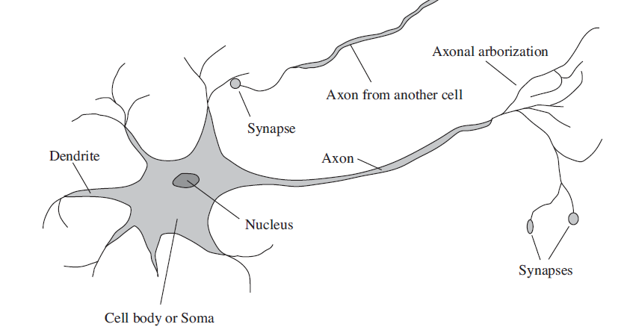
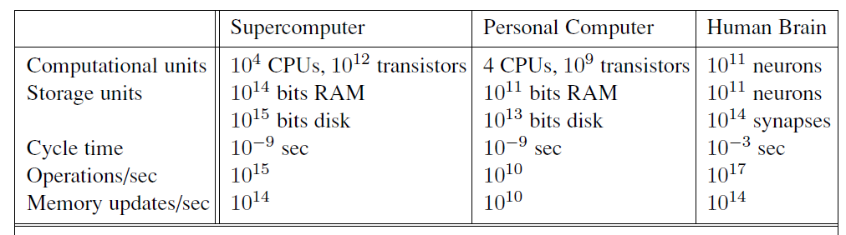
Foundations of Artificial Intelligence (AI) (5)
Neuroscience

Slide 11
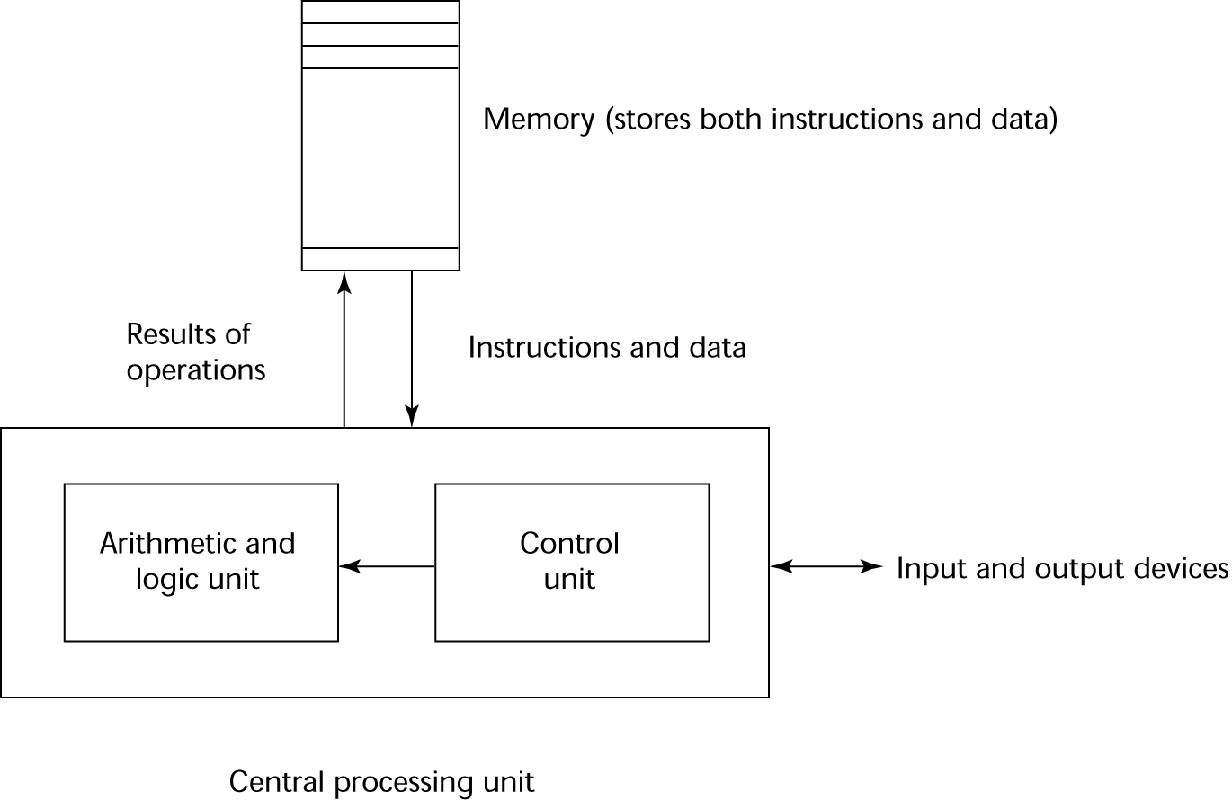
History of Artificial Intelligence (1)
Gestation of Artificial Intelligence (1943 -55)
Warren McCulloch and Pitt (1943) demonstrated using propositional logic from Russel and Turing theory of computation and physiological function of neuron with a principle called Hebbian learning
First Neural Network Computer built in 1950 by Marvin Minsky and Dean Edmonds called SNARC simulating 40 neurons

Slide 12
History of Artificial Intelligence (2)
Origins
The Dartmouth conference: 1956 (AI became a Separate Field)
John McCarthy (Stanford)
Marvin Minsky (MIT)
Herbert Simon (CMU)
Allen Newell (CMU)
Arthur Samuel (IBM)
The Turing Test (1950)
“Machines who Think”
By Pamela McCorckindale

Slide 13
Periods in AI (1)
Early period - 1950’s & 60’s
Game playing
brute force (calculate your way out)
Theorem proving
symbol manipulation
Biological models
neural nets
Symbolic application period - 70’s
Early expert systems, use of knowledge, Fuzzy logic
Commercial period - 80’s
boom in knowledge/ rule bases
Notes:
A physical symbol system (PSS)
consists of symbols (patterns) which are combinable into expressions
there are processes which operate on these symbols to create new symbols and expressions
consider for instance English as a physical symbol system
symbols are the alphabet
expressions are words and sentences
the processes are the English grammar and parsers and dictionaries
The PSS Hypothesis states that a PSS has the necessary and sufficient means for intelligent action
a computer is a PSS
if the PSS Hypothesis is true, then it should be possible to program a computer to produce intelligent actions
this is the (or a) goal of AI
if the PSS Hypothesis is not true, what are the consequences for AI?

Slide 14
Periods in AI (2)
Period - 90’s and New Millennium
Real-world applications, modelling, better evidence, use of theory, ......?
Topics: data mining, formal models, GA’s, fuzzy logic, agents, neural nets, autonomous systems
Applications
visual recognition of traffic
medical diagnosis
directory enquiries
power plant control
automatic cars

Slide 15
Trends in Artificial Intelligence
Progress goes in stages, following funding booms and undergoes crisis:
Some examples:
1. Machine translation of languages
1950’s to 1966 - Syntactic translators
1966 - all US funding cancelled
1980 - commercial translators available
2. Neural Networks
1943 - first AI work by McCulloch & Pitts
1950’s & 60’s - Minsky’s book on “Perceptrons” stops nearly all work on nets
1986 - rediscovery of solutions leads to massive growth in neural nets research
The UK had its own funding freeze in 1973 when the Lighthill report reduced AI work severely -Lesson: Don’t claim too much for your discipline!!!!
Look for similar stop/go effects in fields like genetic algorithms and evolutionary computing. This is a very active modern area dating back to the work of Friedberg in 1958.

Slide 16
Symbolic vs Non-Symbolic AI
Symbolic AI
- is concerned with describing and manipulating our knowledge of the world as explicit symbols
-where these symbols have clear relationships to entities in the real world.
Sub-symbolic AI (e.g. neural-nets)
- is more concerned with obtaining the correct response to an input stimulus without ‘looking inside the box’ to see if parts of the mechanism can be associated with discrete real world objects.
Notes:
Symbolic AI:
known symbols explicitly
Sub-symbolic AI:
need some principles to help solve problems

Slide 17
Rational agents
An agent is an entity that perceives and acts
The topic is about designing rational agents or Intelligent Agents
Abstractly, an agent is a function from percept histories to actions:
[f: P* 🡪 A]
For any given class of environments and tasks, we seek the agent (or class of agents) with the best performance
Caveat: computational limitations make perfect rationality unachievable
🡪 design best program for given machine resources

Slide 18
Learning Outcomes with the Topic
Foundation of Artificial Intelligence
Concept of Rational Thinking and Intelligent Agent(s)

Slide 19
Methodology And Assessment Criterias
Class Assignment(s)
Each chapter being covered will have one assignment. The Case Studies will be given in line to the Changing with Speed across IT Projects in Kirirom
Internal Exam(s)
There will be 2 exams
Model Exam
There will be one Model Exam.
Semester Exam
There will be 1 Semester Exam

Slide 20
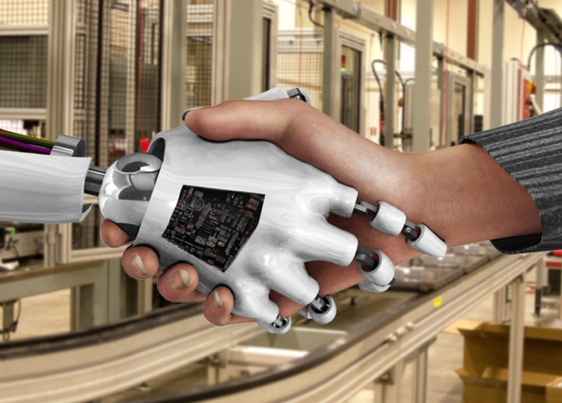
Thank You !
“What all of us have to do is to make sure we are using AI in a way that is for the benefit of humanity, not to the detriment of humanity.” - Tim Cook

